Slide 1
K-Means Clustering
1 March 2016

Slide 2
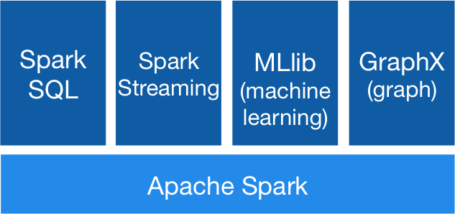

Slide 3
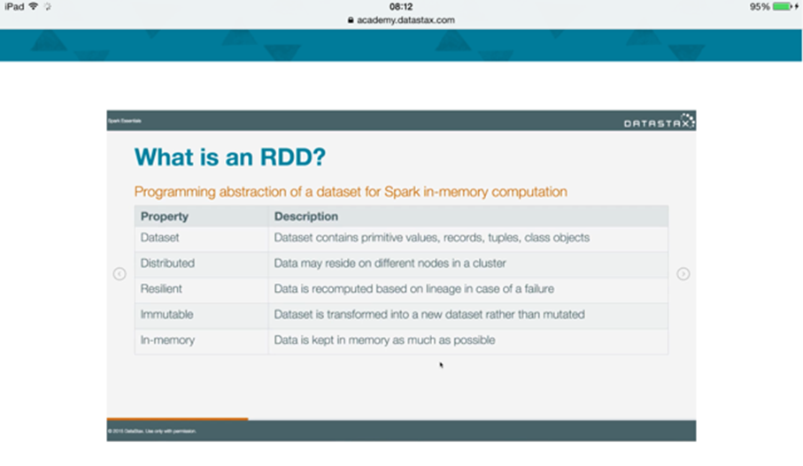

Slide 4
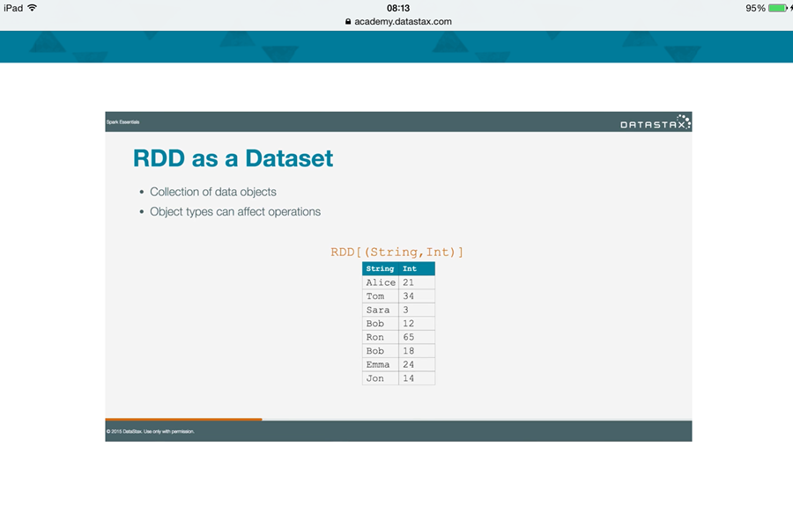

Slide 5
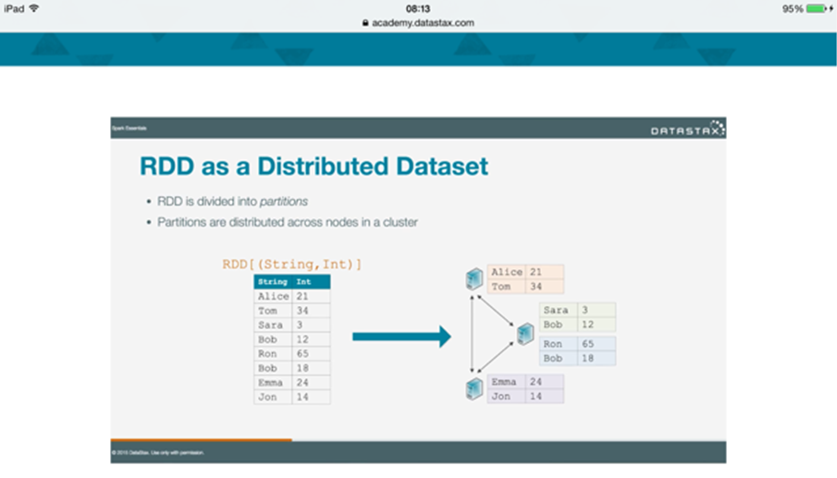

Slide 6
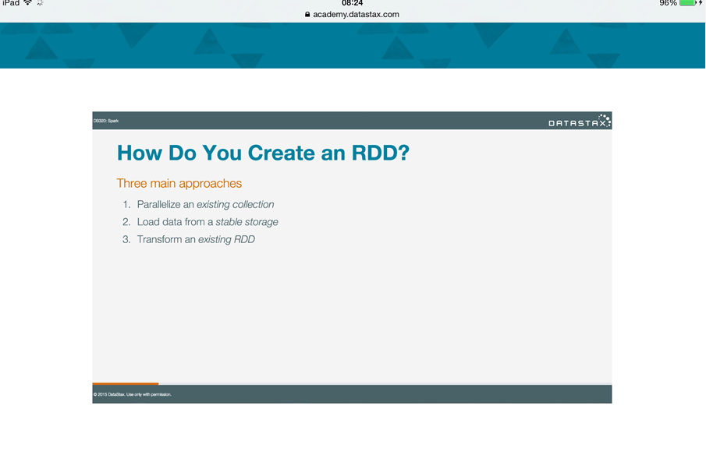

Slide 7
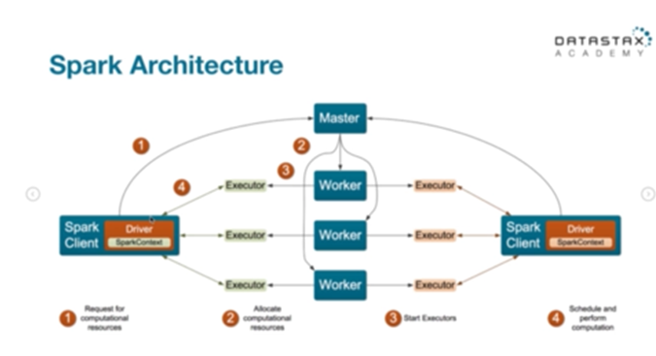

Slide 8
How to launch spark?
osboxes@osboxes:/$ dse spark

Slide 9
Example: “Hello World”
import org.apache.spark.SparkConf
import org.apache.spark.SparkContext
import org.apache.spark.SparkContext._
// Load the lines from our input data
val input = sc.textFile ("file:///usr/share/dse/demos/spark/README.txt")
// Split it up into words
val words = input.flatMap(line => line.split(" "))
// Transform the words into pairs
val pairs= words.map(words => (words, 1))
// Group the pairs by key
val counts = pairs.reduceByKey{case (x,y) => x + y}
// Print the paris
counts.collect().foreach(println)

Slide 11
Machine Learning Library (MLlib)
Common learning algorithms
Classification,
Regression
Clustering
Collaborative filtering
Dimensionality reduction

Slide 12
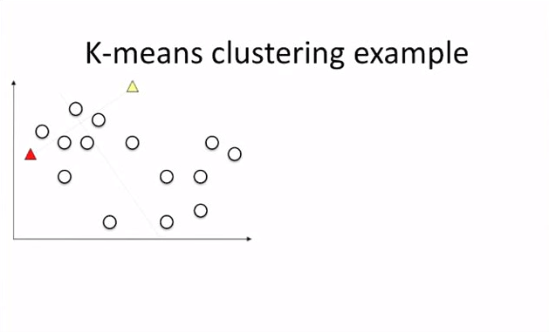
Randomly pick the two centroids (k = 2)
Notes:
https://www.youtube.com/watch?v=_aWzGGNrcic

Slide 13
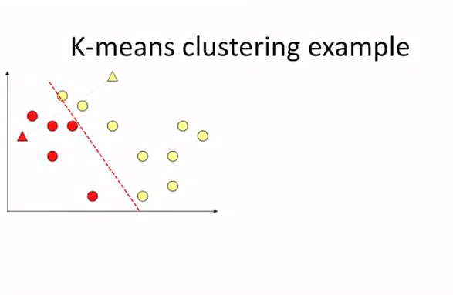
Draw a line to divide the data into one of the two clusters

Slide 14
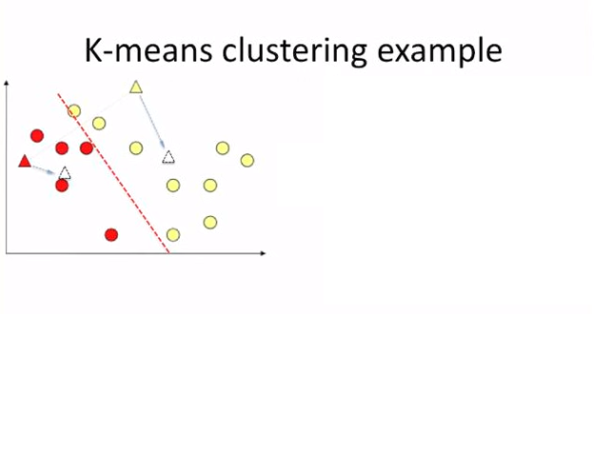
Recalculate the new centroid per cluster

Slide 15
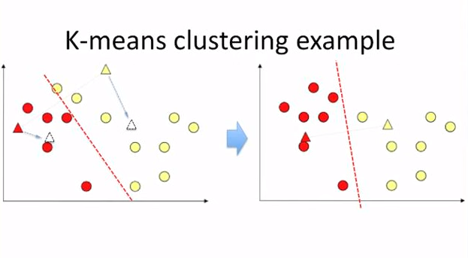
Two yellow dots are closer to the red centroid

Slide 16
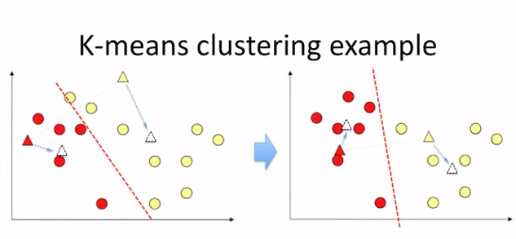
Redraw the line based on the new centroids

Slide 17
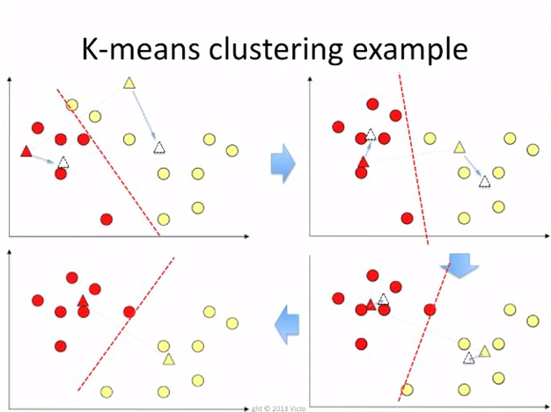
Repeat the process, four iterations shown below

Slide 18
How many iterations do we need?
-When the ‘dots’ don’t change color anymore
-A fixed number of times
-If the centroids barely move positions

Slide 19
MLlib - Data Types
Underlying data types for the ML algorithms
Local vector
Labeled point
Local matrix
Distributed matrix

Slide 20
Local vector
Dense Vector:
A single array of doubles representing its entry values
Example: (1.0, 0.0, 3.0)
Sparse Vector
Two parallel arrays: indices and values.
Example: (3, [0, 2], [1.0, 3.0])
3 is the size of the vector.
Element 0 and element 2 have values
The values are 1.0 and 3.0

Slide 21
Exercise
1 March 2016

Slide 22
How to launch spark?
osboxes@osboxes:/$ dse spark

Slide 23
Training the model
import org.apache.spark.mllib.clustering.{KMeans, KMeansModel}
import org.apache.spark.mllib.linalg.Vectors
// Load and parse the data
val data = sc.textFile("file:///tmp/kmeans_data.txt")
val parsedData = data.map(s => Vectors.dense(s.split(' ').map(_.toDouble))).cache()
// Cluster the data into two classes using KMeans
val numClusters = 2
val numIterations = 20
val clusters = KMeans.train(parsedData, numClusters, numIterations)
clusters.collect().foreach(println)
// Evaluate clustering by computing Within Set Sum of Squared Errors
val WSSSE = clusters.computeCost(parsedData)
println("Within Set Sum of Squared Errors = " + WSSSE)
Notes:
http://spark.apache.org/docs/latest/mllib-clustering.html

Slide 24
Testing the model
val testdata = sc.textFile("file:///tmp/kmeans_testdata.txt")
val parsedTestData = testdata.map(s => Vectors.dense(s.split(' ').map(_.toDouble))).cache()
val pr2 = clusters.predict(parsedTestData)
pr2.collect().foreach(println)
Notes:
http://spark.apache.org/docs/latest/mllib-clustering.html

Slide 25
Assignment
Use intellisense to see the methods and properties of the ‘clusters’ variable
What are the clusters Centers? Does that change if number of iterations is 1?
Change some data
Change the number of iterations,
Change the number of clusters,
How do the changes effect the outcome of the computeCost function?
Capture the ppml
What does a high value for computeCost mean?
Run the ‘predict’ method

Slide 26
PMML output
<?xml version="1.0" encoding="UTF-8" standalone="yes"?>
<PMML xmlns="http://www.dmg.org/PMML-4_2">
<Header description="k-means clustering">
<Application name="Apache Spark MLlib" version="1.4.2.2"/>
<Timestamp>2016-03-13T16:43:57</Timestamp>
</Header>
<DataDictionary numberOfFields="3">
<DataField name="field_0" optype="continuous" dataType="double"/>
<DataField name="field_1" optype="continuous" dataType="double"/>
<DataField name="field_2" optype="continuous" dataType="double"/>
</DataDictionary>
<ClusteringModel modelName="k-means" functionName="clustering" modelClass="centerBased" numberOfClusters="2">
<MiningSchema>
<MiningField name="field_0" usageType="active"/>
<MiningField name="field_1" usageType="active"/>
<MiningField name="field_2" usageType="active"/>
</MiningSchema>
<ComparisonMeasure kind="distance">
<squaredEuclidean/>
</ComparisonMeasure>
<ClusteringField field="field_0" compareFunction="absDiff"/>
<ClusteringField field="field_1" compareFunction="absDiff"/>
<ClusteringField field="field_2" compareFunction="absDiff"/>
<Cluster name="cluster_0">
<Array n="3" type="real">0.1 0.1 0.1</Array>
</Cluster>
<Cluster name="cluster_1">
<Array n="3" type="real">9.1 9.1 9.1</Array>
</Cluster>
</ClusteringModel>
</PMML>

